Slide 1
2022-2023 District 22 Spring Business Council Meeting Agenda
May 19, 2023

Slide 2
District Mission/Vision
We build new clubs and support all clubs in achieving excellence.
District Theme: D.U.T.Y with District 22 - (Golden Rule) Do Unto Others as You Would Have Them Do Unto You. Unity. Take Care of Yourself!

Slide 3
Agenda
District Mission\Vision
Adopt Meeting Agenda
Meeting Officials Introduction
Voting Procedures
Credentials Committee Chair Report
Adopt Special Rules of Order
Approve September 22, 2022, District Council Minutes
Audit Committee Report
Profit & Loss Report
Approve District Alignment Report
Approve 2023-2024 District Elected Leadership

Slide 4
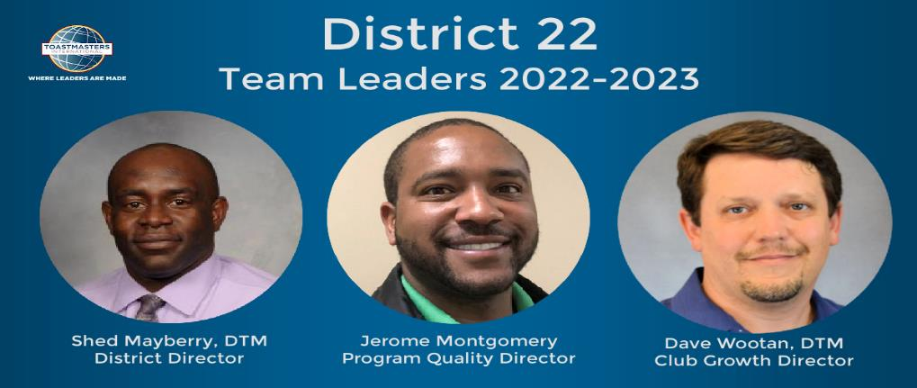
Thank you for attending: Your Current District Leadership Team

